Slide 1


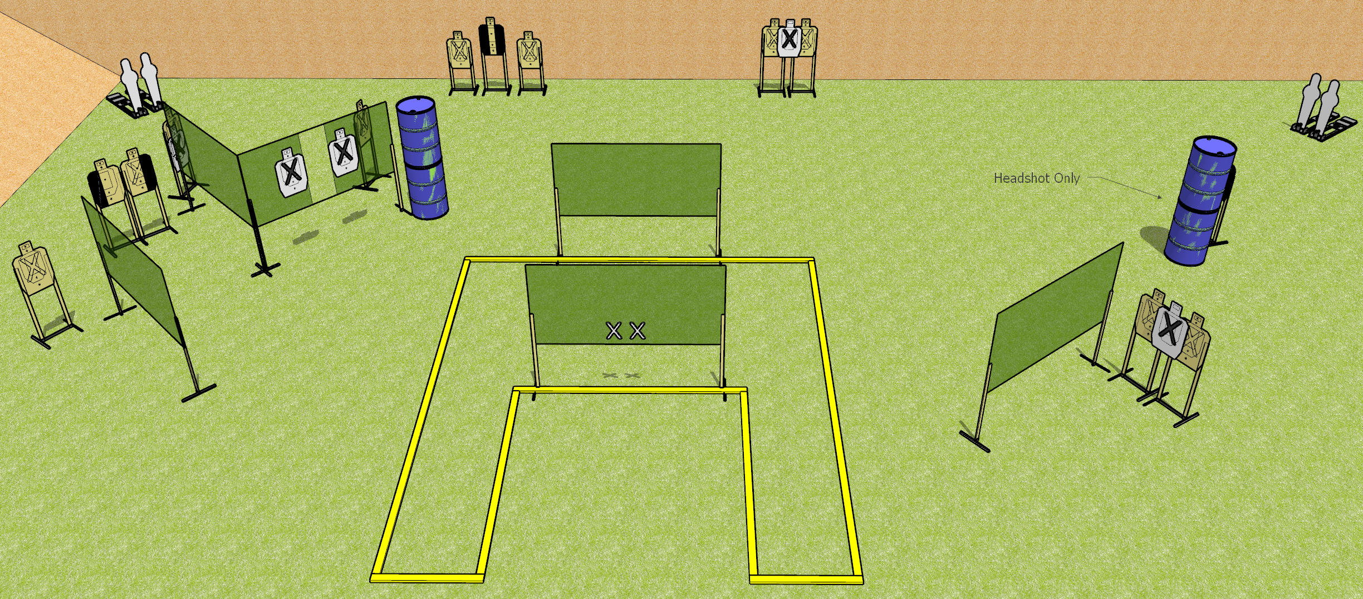
 | Dothan Gun Club – USPSA Match Uhhh Course Designer : Drew Coleman
START POSITION : Standing palms flat on mark. PCC muzzle touching either mark, shouldered held with both hands.
GUN READY CONDITION : Pistol loaded and holstered. |  | SCORING: Comstock, 30 rounds TARGETS: 13 paper, 4 Steel SCORED HITS: Best 2 on paper, steel until down START-STOP: Audible, last shot RULES:
STAGE PROCEDURE: Engage targets as they become available from within the fault lines

